Slide 1
Are you taking the opportunity to improve your success and progression?
Are you using bksb Live to help develop your
English & maths skills?
Now that’s clever!

Slide 2
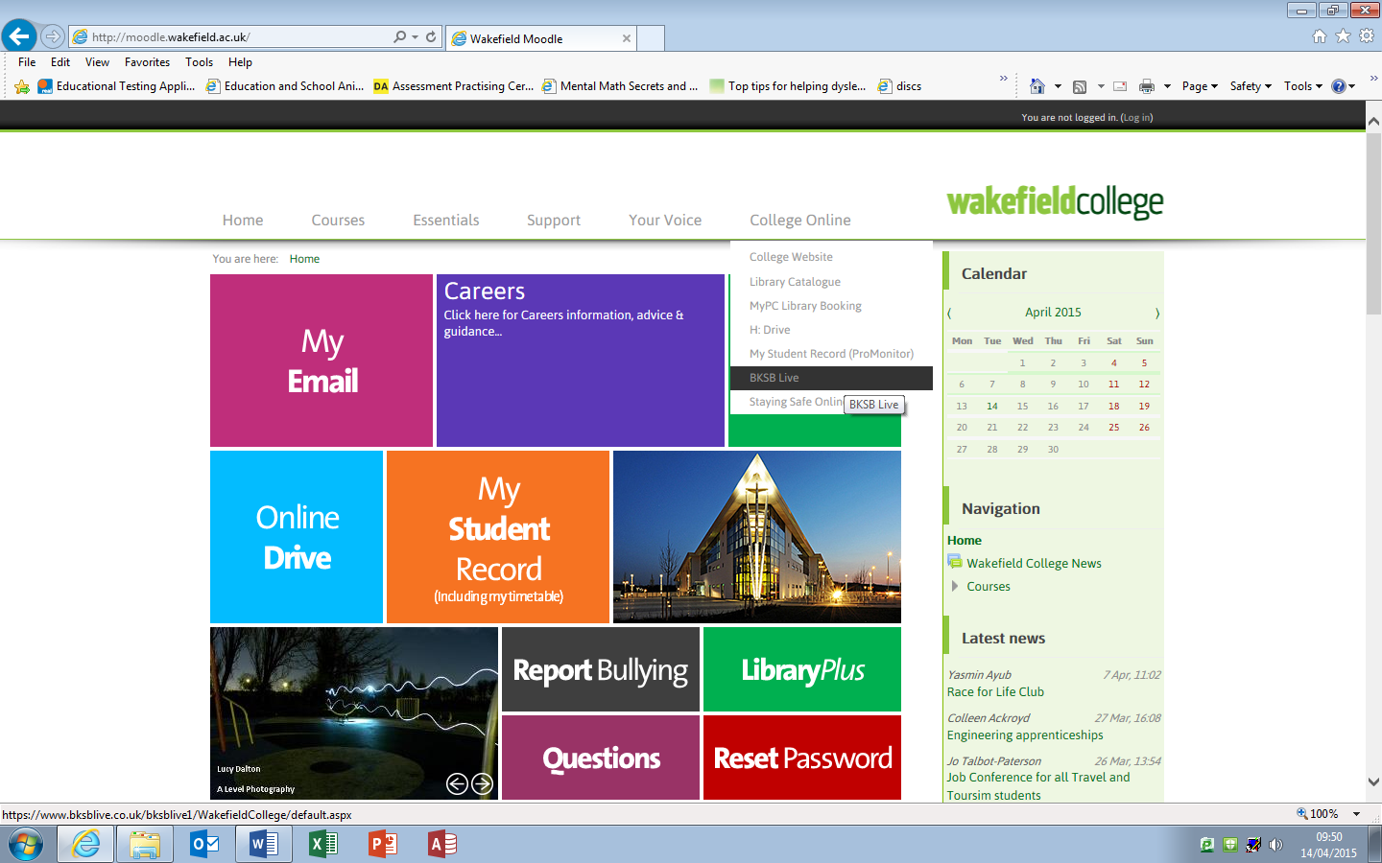
Use the College Online tab on Moodle - in college or at home - to get onto bksb Live and work through your interactive learning resources to brush-up your skills.

Slide 3
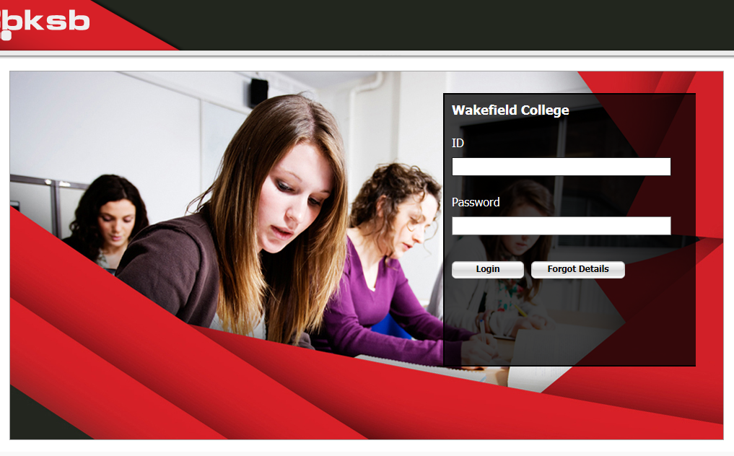
Log-in using your college ID number and previously chosen password
Forgot your password?
No problem – just click the ‘Forgot Details’ button and an activation link will be sent to your college email.
Any problems call in at the ARC (Achievement Resource Centre) where the Study Support Assistants will be happy to help.

